Slide 1
Physical Examination 1 – “Beginning well”
Joel F. Vaughan, MD

Slide 2
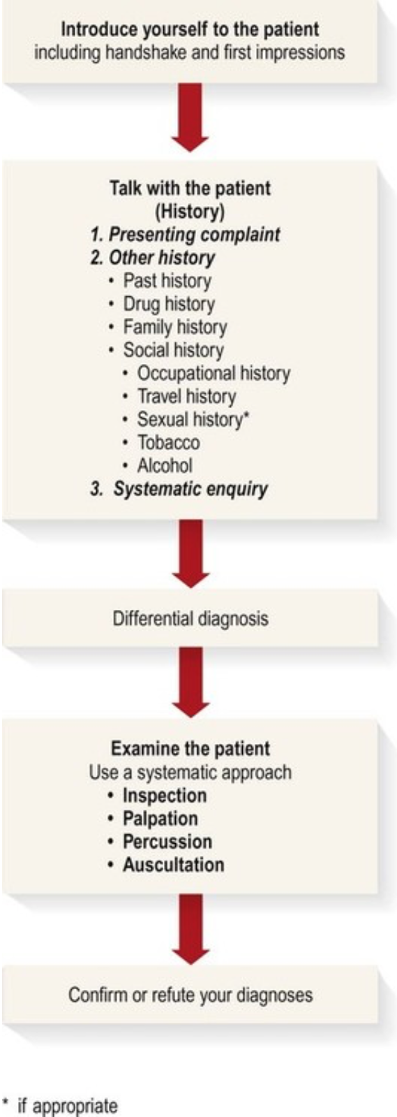
Context
Where does examination fit in the consultation?
When does examination begin?
When does examination end?
Notes:
Consider talking about:
What is examined
How the Physical Exam is Charted

Slide 3
First Things
Privacy
Permission
Professionalism

Slide 4
Position
Patient comfortable
You on patient’s right side
Access to Area of Interest
Exposure
Notes:
Consider talking about:
Routine physicals
Comprehensive physicals
Pre-employment examinations
Insurance exams

Slide 5
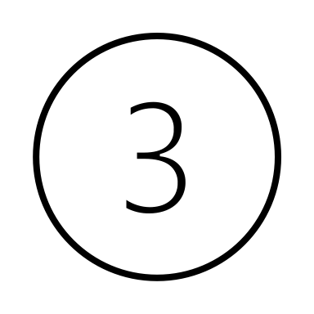
Sequence
Inspection
Palpation
Percussion
Auscultation
Notes:
Consider talking about:
Diagnosis
Screening
Establishing doctor-patient relationship

Slide 6
Summary
Starting well is important
Physical examination generally starts after taking history
Make there is privacy (chaperone as needed)
Make sure you have patient’s permission
Position the patient correctly and expose the area of the examination
Proceed through:
Inspection (Look)
Palpation (Touch)
Percussion (Tap)
Auscultation (Listen)

