Slide 1
General Examination 3
Joel F. Vaughan, M.D.

Slide 2
Context

Slide 5
Consciousness

Slide 7
Assessment of Consciousness
Alert
Lethargic
Obtunded
Stuporous
Comatose

Slide 8
Hydration

Slide 9
Hydration
Why is this so important?
Humans 60 to 65% water
Varies by age and gender
Crucial for maintaining metabolism
Crucial for maintaining circulation
…

Slide 10
Hydration
Dehydration
Not enough water
Difficult to assess
Easy to underestimate fluid loss
Overhydration
Too much water
More evident than dehydration

Slide 11
Dehydration
Weight (1 L = 1 kg)
Pulse rate and quality (>100)
Blood pressure (low, falls >15 mmHg when upright)
Skin and soft tissues (sunken eyes, dry mucous membranes, loss of skin turgor)

Slide 12
Overhydration
Weight
Edema (gravity pulls to dependent areas, not always due to fluid overload)
Jugular venous pressure (JVP)

Slide 13
Lumps, Bumps, and Swelling

Slide 14
SPACESPIT

Slide 15
How to do it?

Slide 16
Lymph nodes

Slide 17
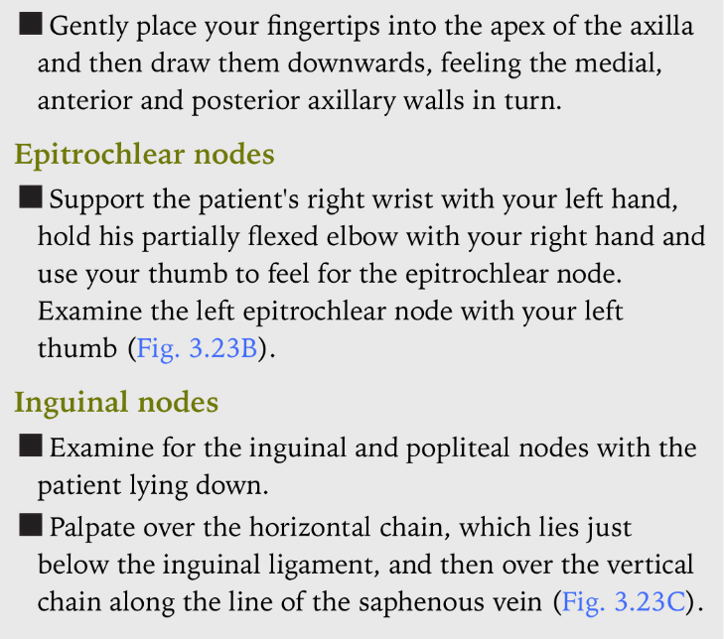

Slide 18
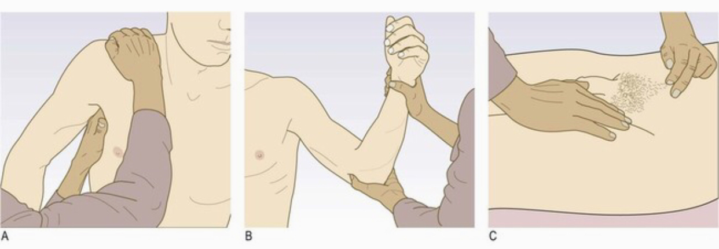

Slide 19
Summary

Slide 20
Summary
When you see the patient, you will have an impression
Better define that impression by specifically describing certain aspects of your observations
From today, make note of:
Consciousness
Hydration status
Lumps
Lymph nodes
Always remember the general examination sequence:
Inspection
Palpation
Percussion
Auscultation

